Slide 1



SAST LAB ACTIVITY
Analysis of vulnerable repositories with SAST and SCA

Slide 2
REPOSITORIES:
Django
Gomoku
TOOLS:
SonarCloud
Trivy scanner

Slide 3
Django
Django. A highly structured, widely adopted open-source Python web framework.
Frequently utilized in enterprise development to handle complex database interactions and rapid backend application deployment.
Created by web developers Adrian Holovaty and Simon Willison in the autumn of 2003
Few dependencies: sqlparse, asgiref, pytz
Some known vulnerabilities in v3.2.13: CVE-2022-34265 (SQL Injection within ORM analytical lookups) and CVE-2021-35042 (SQL Injection risks in QuerySet filters)

Slide 4
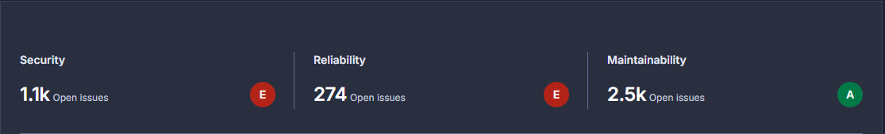
DJANGO V3.2.13 (SAST)

Slide 5
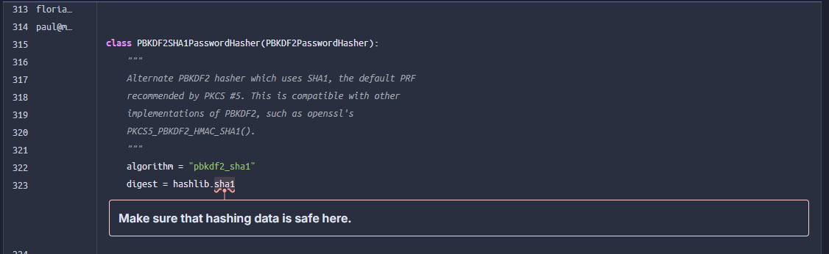
HIGH SEVERITY SECURITY ISSUE EXAMPLE

Slide 6
HIGH SEVERITY SECURITY ISSUE EXAMPLE
SonarCloud flagged multiple instances of hashlib.sha1 and pbkdf2_sha1 with the warning: "Make sure that hashing data is safe here."
Automated SAST rule matching detects the SHA-1 signature, which is mathematically deprecated due to collision risks.
Code inspection reveals this is the PBKDF2SHA1PasswordHasher class, maintained purely for legacy database migration and backward compatibility.
Framework defaults prioritize SHA-256 and Argon2 for new secret creation; the flagged code is never executed unless explicitly declared for legacy support.

Slide 7
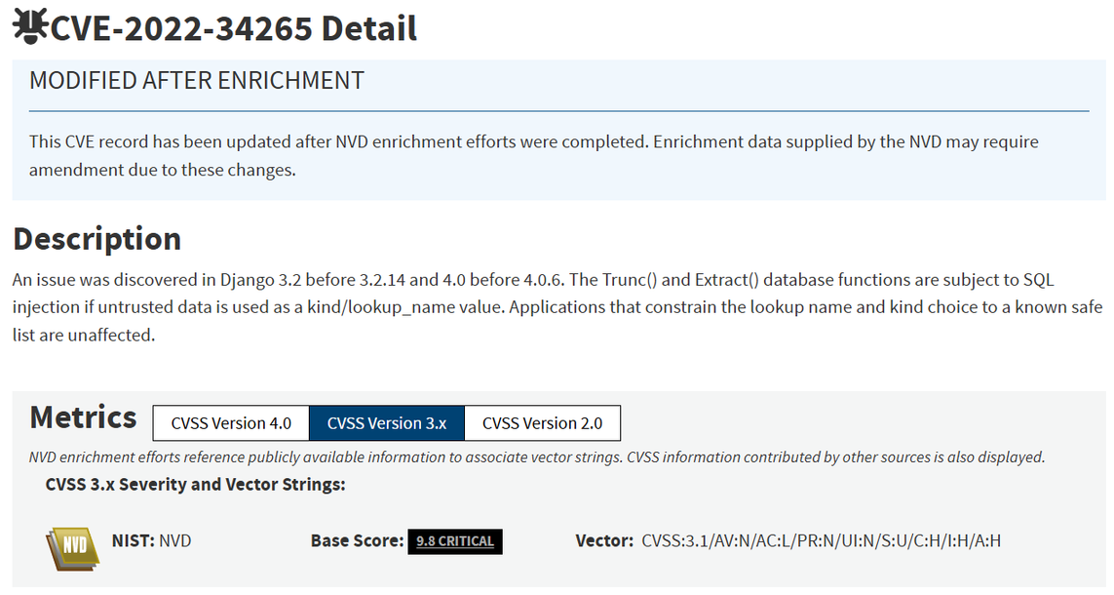
DJANGO V3.2.13 - SAMPLE CVE
Fixed in v3.2.14
SQL injection in Trunc() and Extract() database functions.
Not spotted by SonarQube (False Negative), probably due to Framework Abstraction.
NVD record: https://nvd.nist.gov/vuln/detail/cve-2022-34265
PoC: https://github.com/aeyesec/CVE-2022-34265

Slide 8
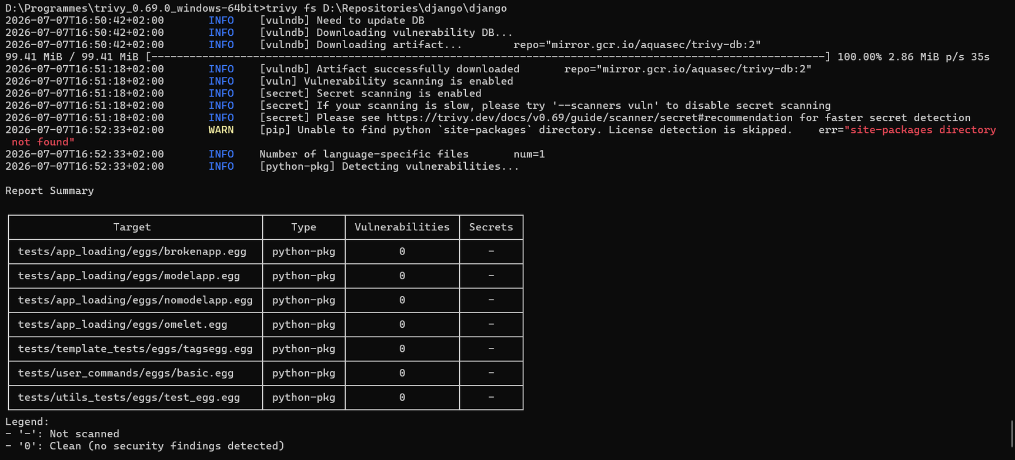
DJANGO V3.2.13 (SCA)
Although django have some dependencies, Trivy doesn't seem to pickup on them.
Probably because django dependencies are in setup.cfg file.
Executed the following command in the repo to have a .txt file with the dependencies.
pip freeze > requirements.txt
Results in the next slides

Slide 9
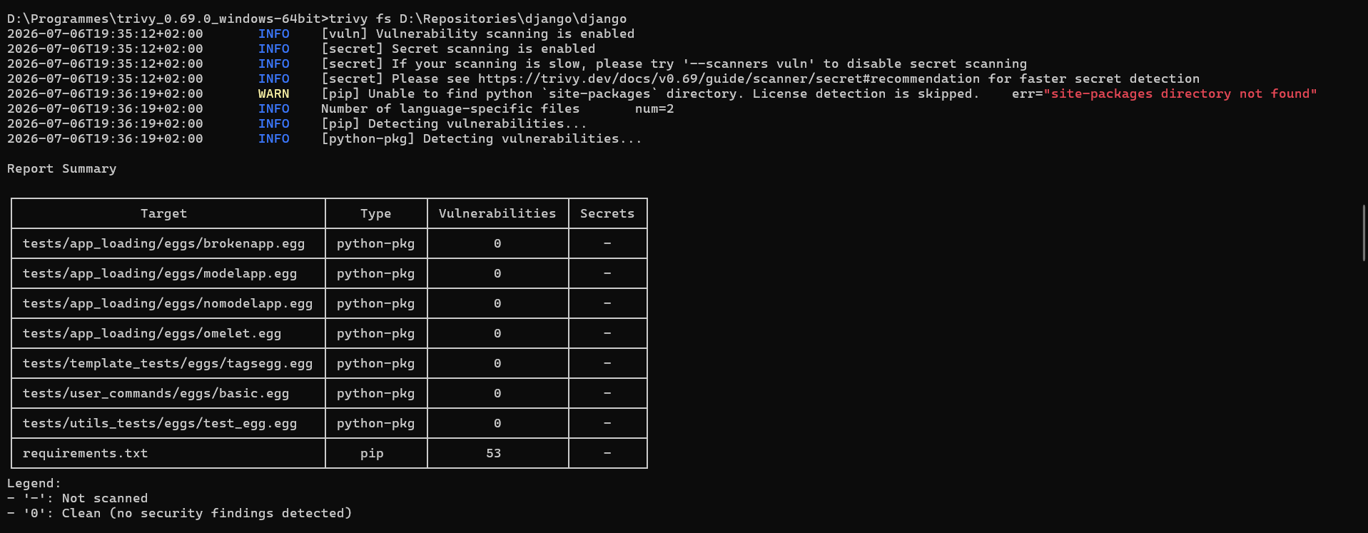
DJANGO V3.2.13 (SCA)

Slide 10
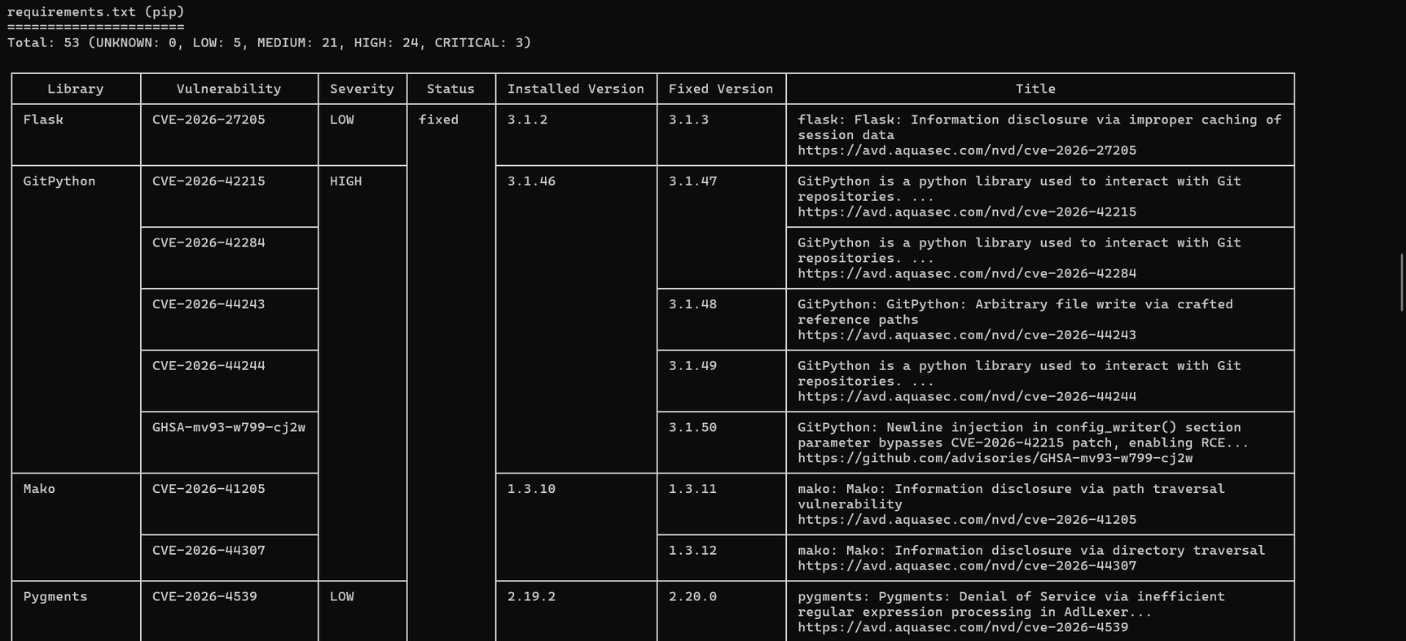
DJANGO V3.2.13 (SCA)

Slide 11
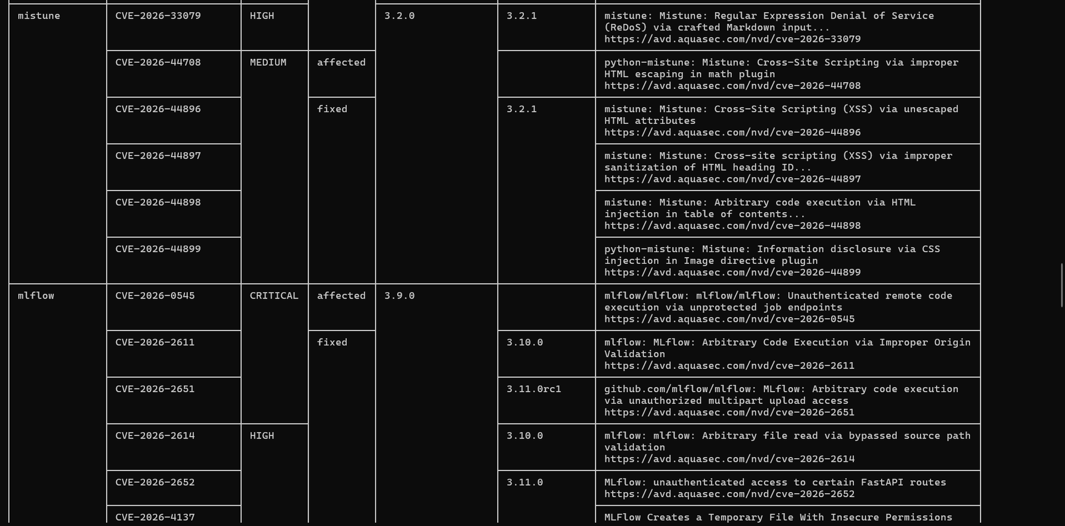
DJANGO V3.2.13 (SCA)

Slide 12
Gomoku
My personal repository
Written in Java
Gomoku is a classic two-player board game implemented in Java for the command line.
Few dependencies:
Maven for building
Mockito and jUnit for testing

Slide 13
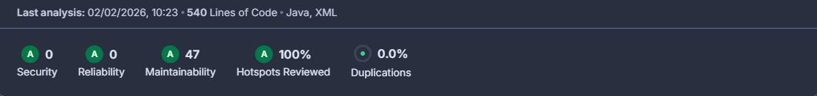
OVERVIEW (SAST)
No security problem identified
No dependency issue identified
As expected from a small and simple project it is relatively “safe

Slide 14
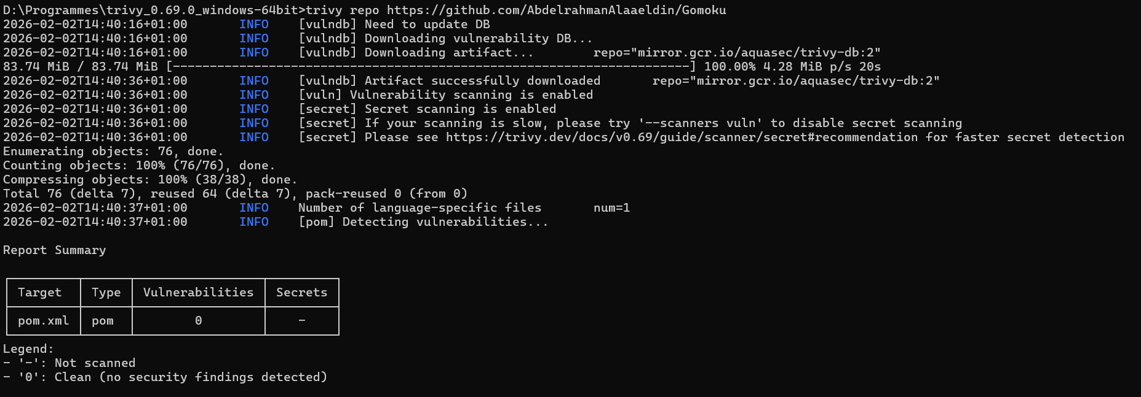
OVERVIEW (SCA)

Slide 15
Thank You

